Slide 1

FEA Lab Project Report
Static and Transient Structural Analysis of a Simple Polygon Structure
Student Name: Abdul Rehman
Roll Number: ME-1878

Slide 2

Project Overview
Introduction
Workflow
Objective
This project performs Static and Transient Structural simulations on a polygonal structure using ANSYS Workbench, with parameters derived from student details.
Covers geometry, material definition, load application, meshing, and analysis for both static and time-dependent loading.
To understand structural behavior under various loading conditions and provide insights into deformation and stress responses.

Slide 3
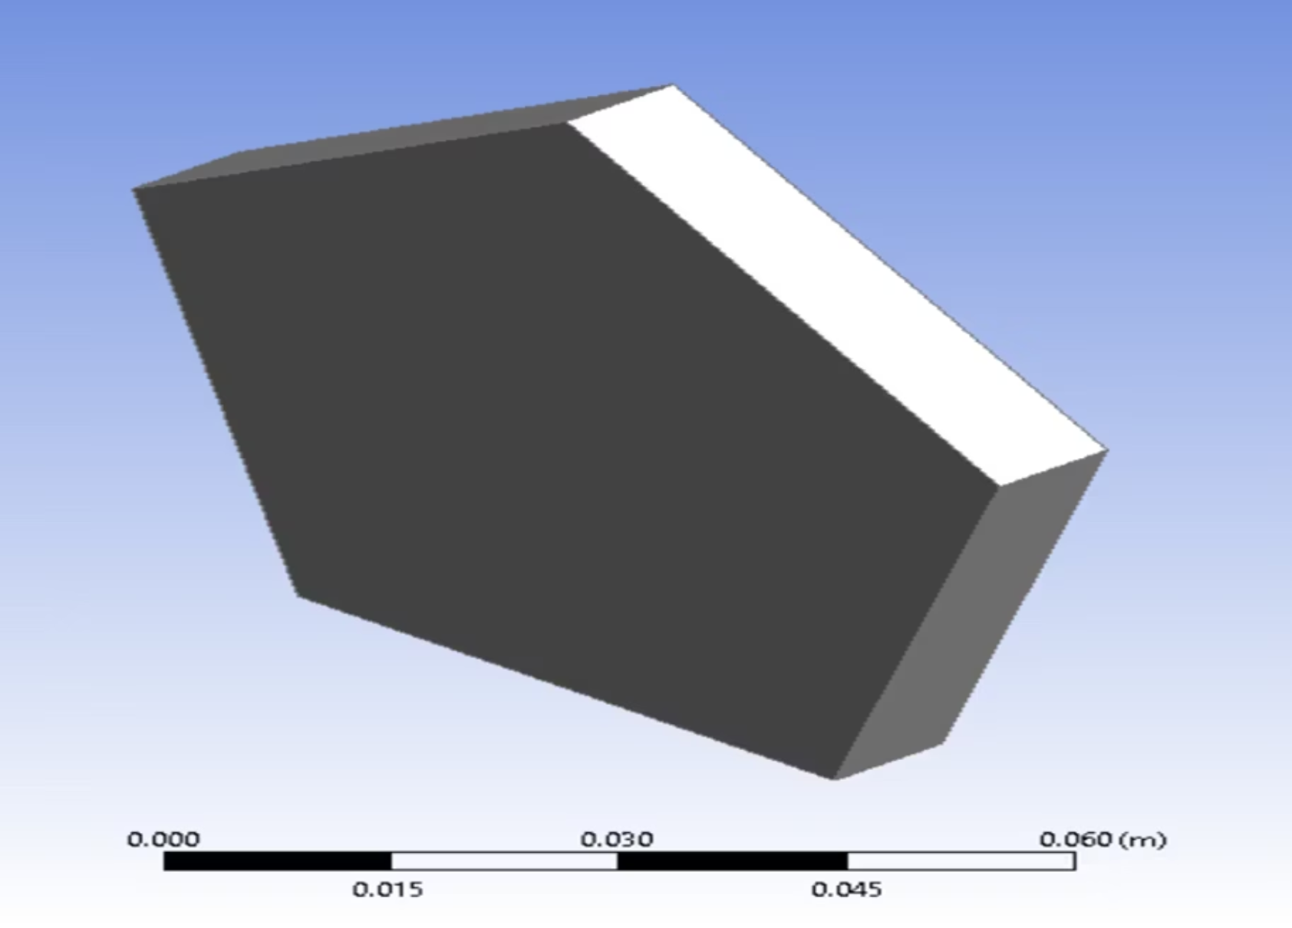
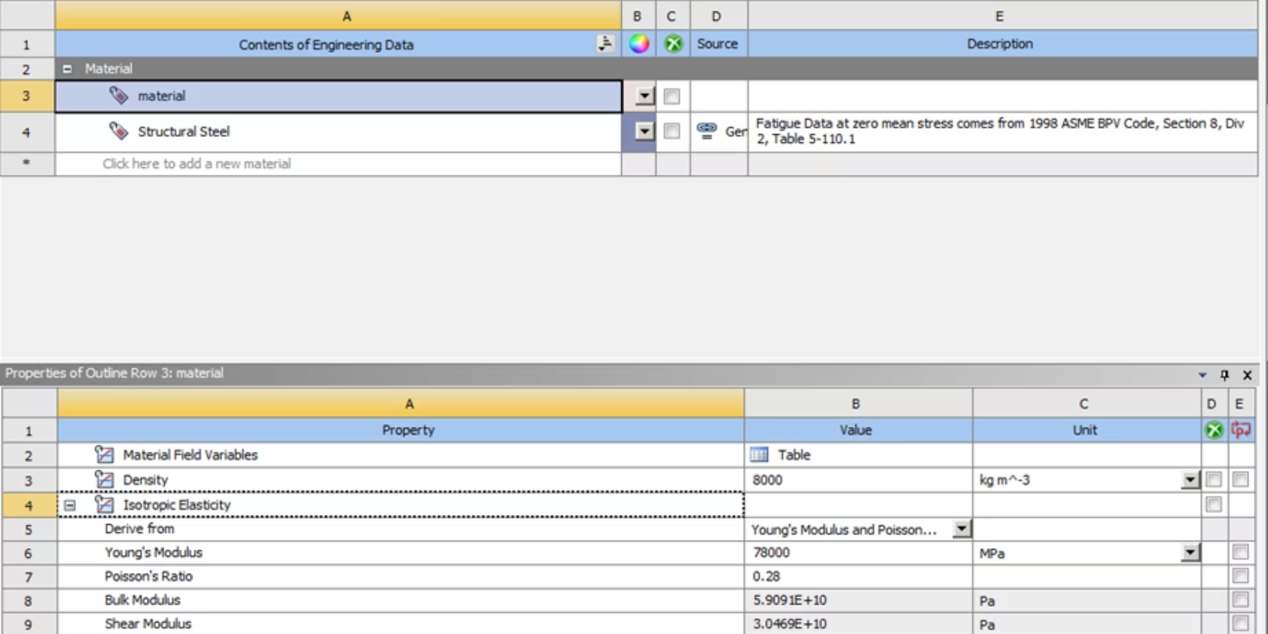
Problem Definition: Geometry & Materials
Material Properties
Geometry Selection
Properties were assigned using specified formulas, representing a moderately stiff, linearly elastic material.
Based on roll number (1878, even), a Regular Pentagon was selected for its symmetry and suitability for load transfer studies.
Elastic Modulus (E): 78,000 MPa
Poisson's Ratio (ν): 0.28

Slide 4
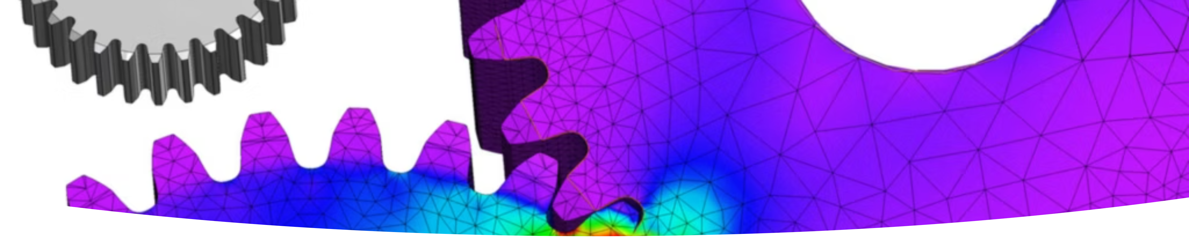
Geometry and Modeling
ANSYS Design Modeler
Key Considerations
A regular pentagon was sketched and extruded to a 3-D solid body.
Horizontal face for fixed support.
Symmetric vertex distribution.
Topology error checks.

Slide 5

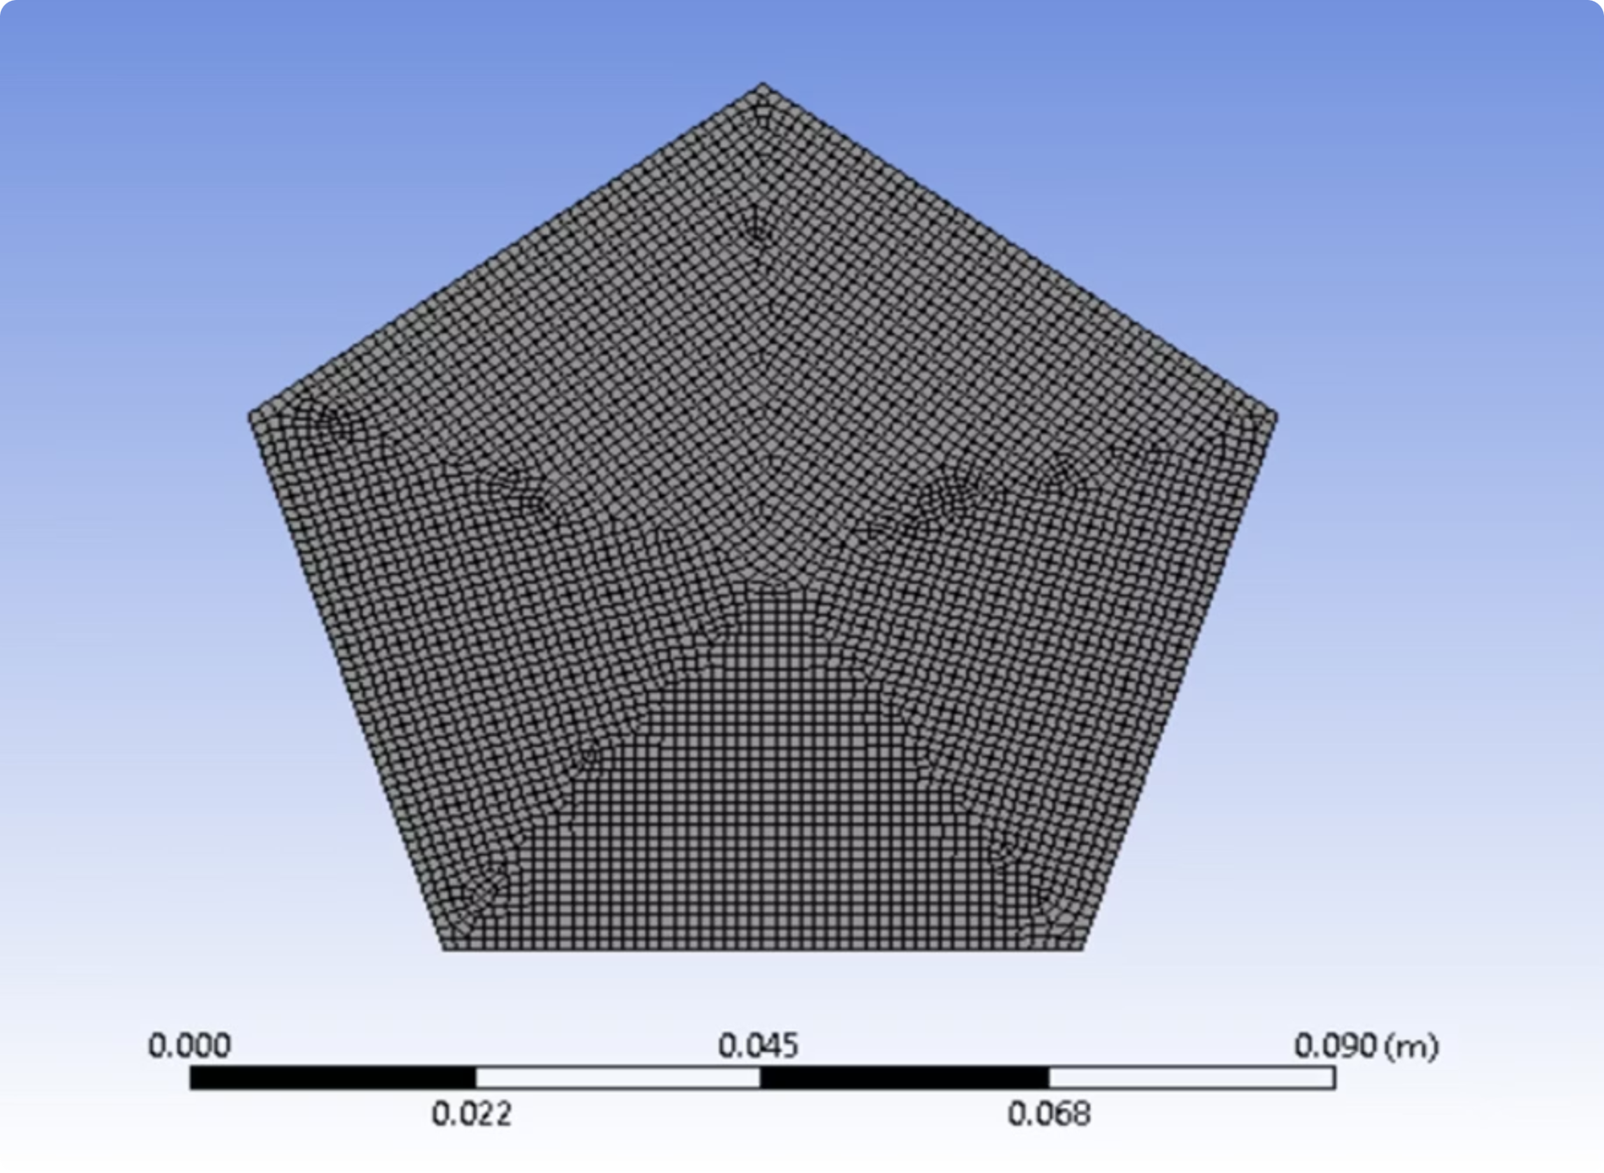




Meshing Strategy
Element Type
Element Quality
Hexahedral-dominant mesh for optimal accuracy.
Verified to prevent skewness and aspect-ratio issues.
Mesh Convergence
Performed for static analysis using multiple densities (coarse to fine) until results stabilized.
Note: Transient explicit analysis lacks an automatic mesh convergence tool in ANSYS.

Slide 6
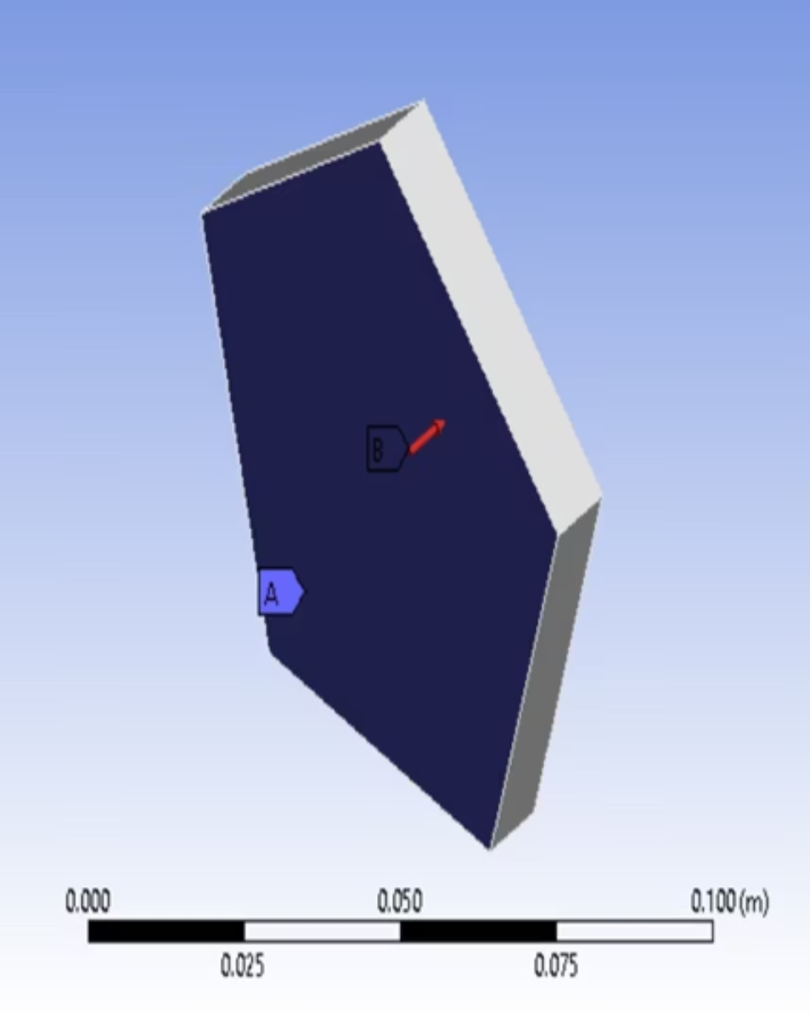
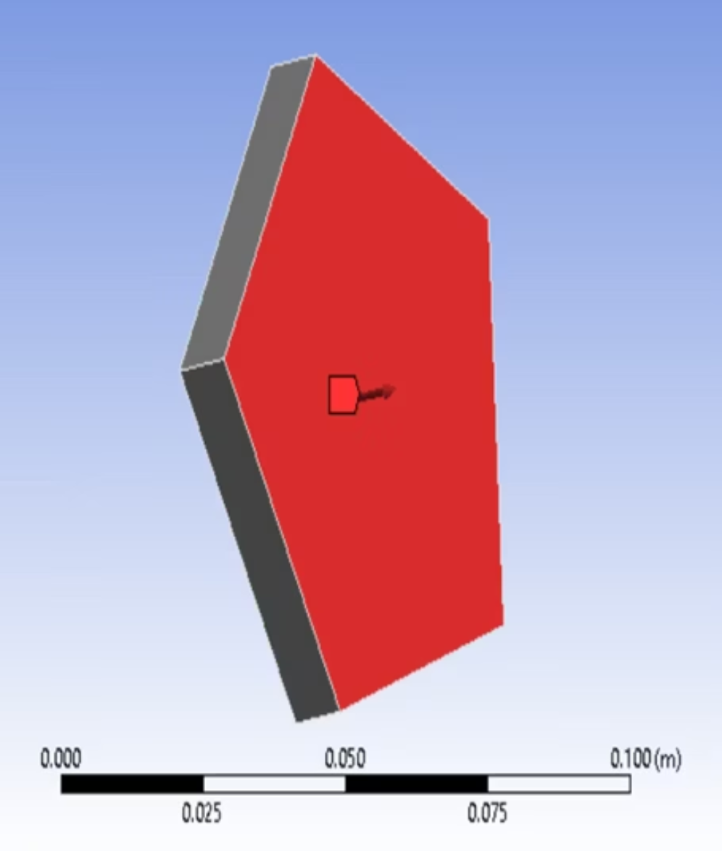
Static Structural Simulation: Boundary Conditions
Fixed Support
Remote Force Application
One complete face of the pentagon was fully constrained in all degrees of freedom.
Force applied at 1/3rd of the fixed face length, calculated from Date of Birth digits.
DOB: 24-11-2003
Sum: 24 + 11 + 2003 = 2038 N

Slide 7
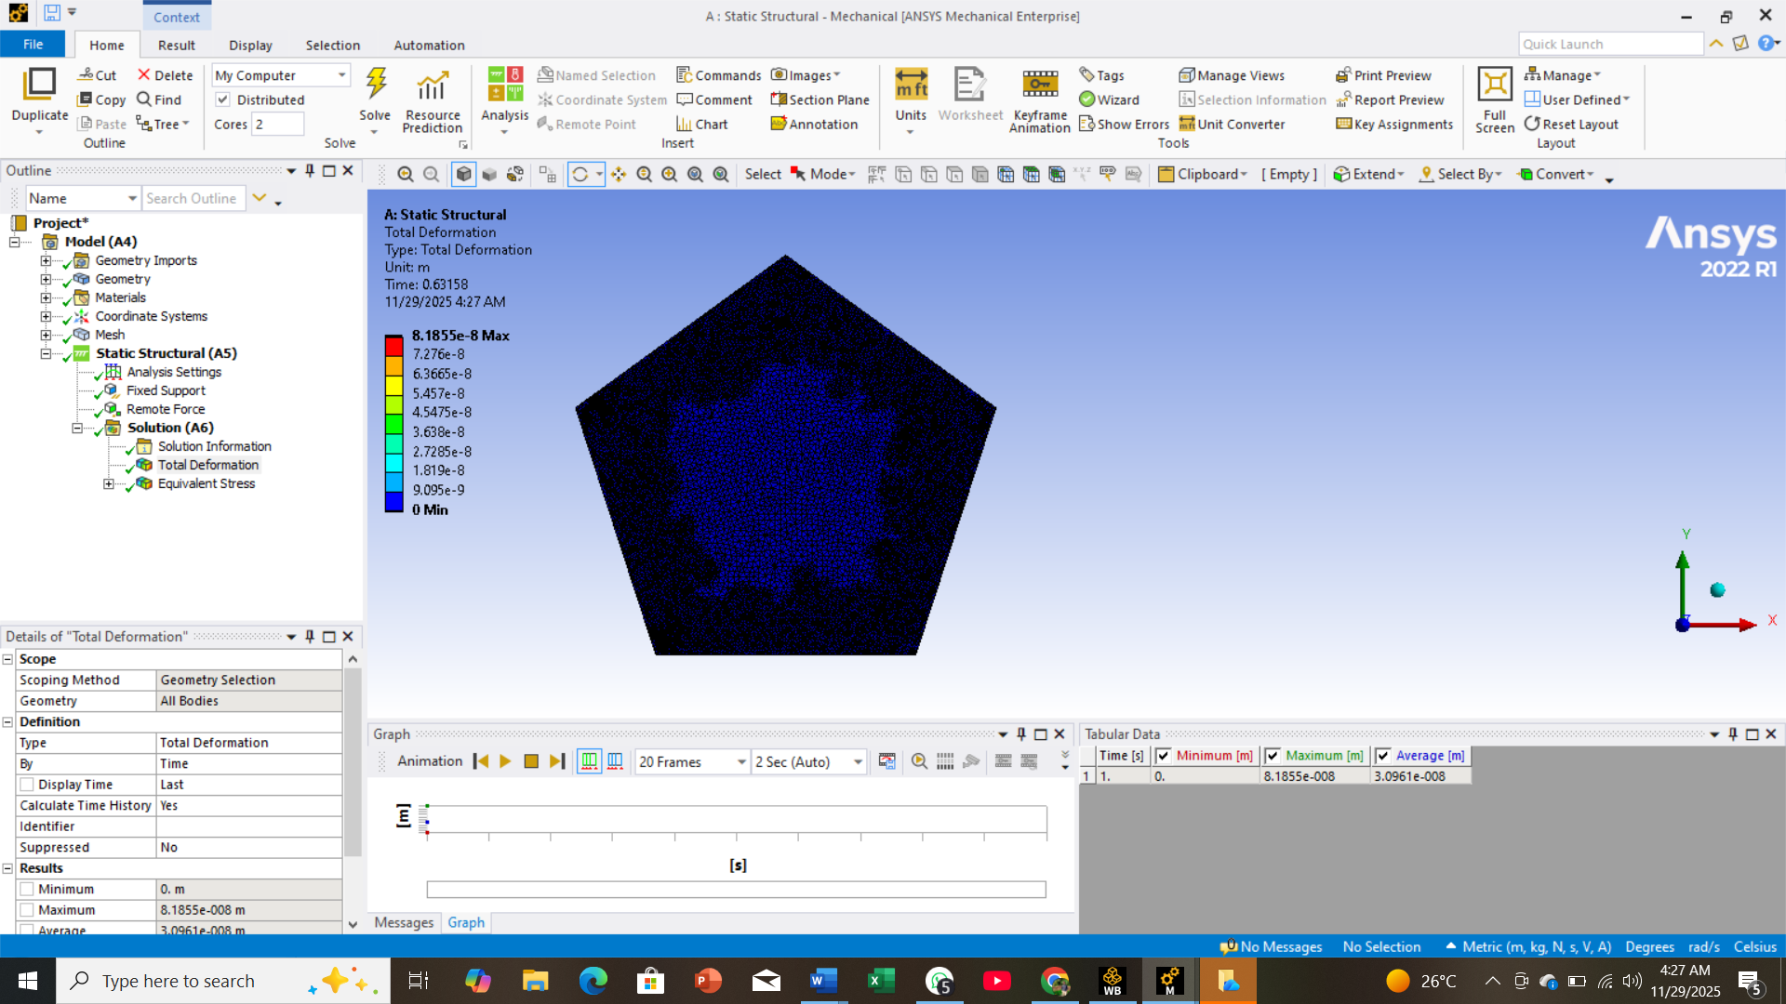
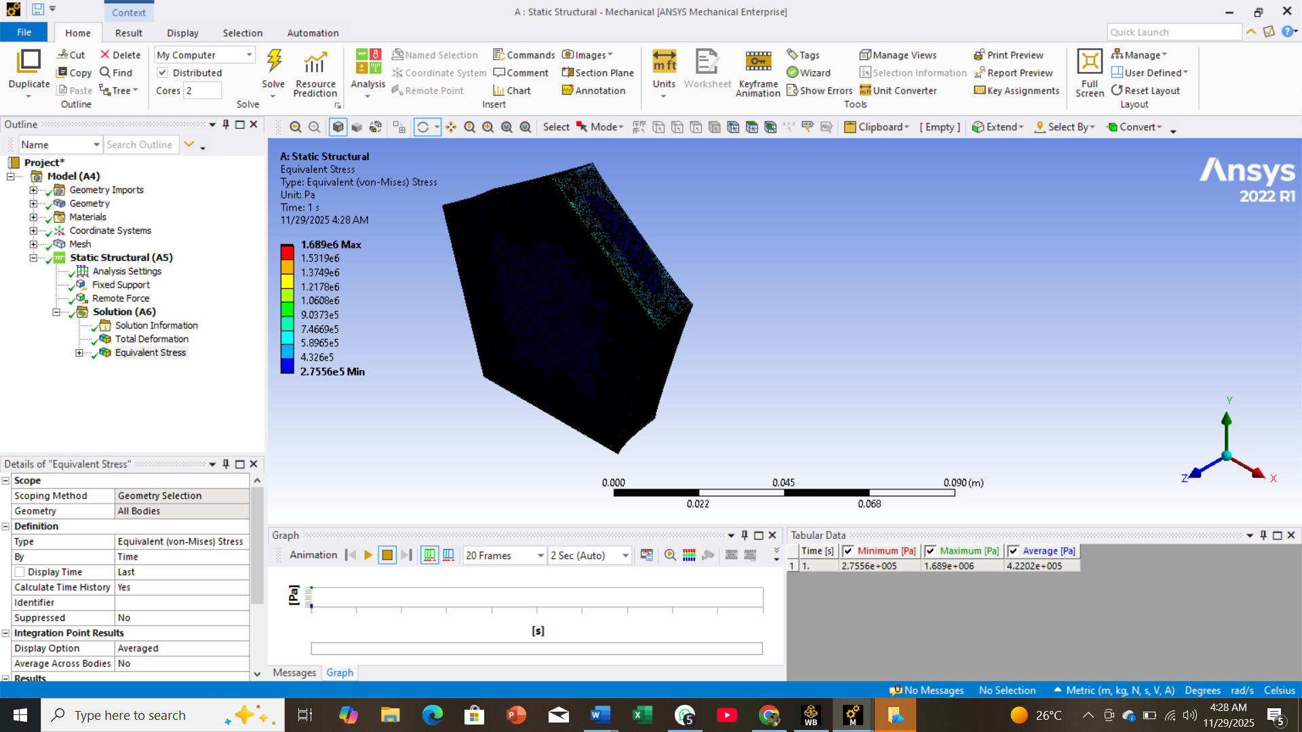
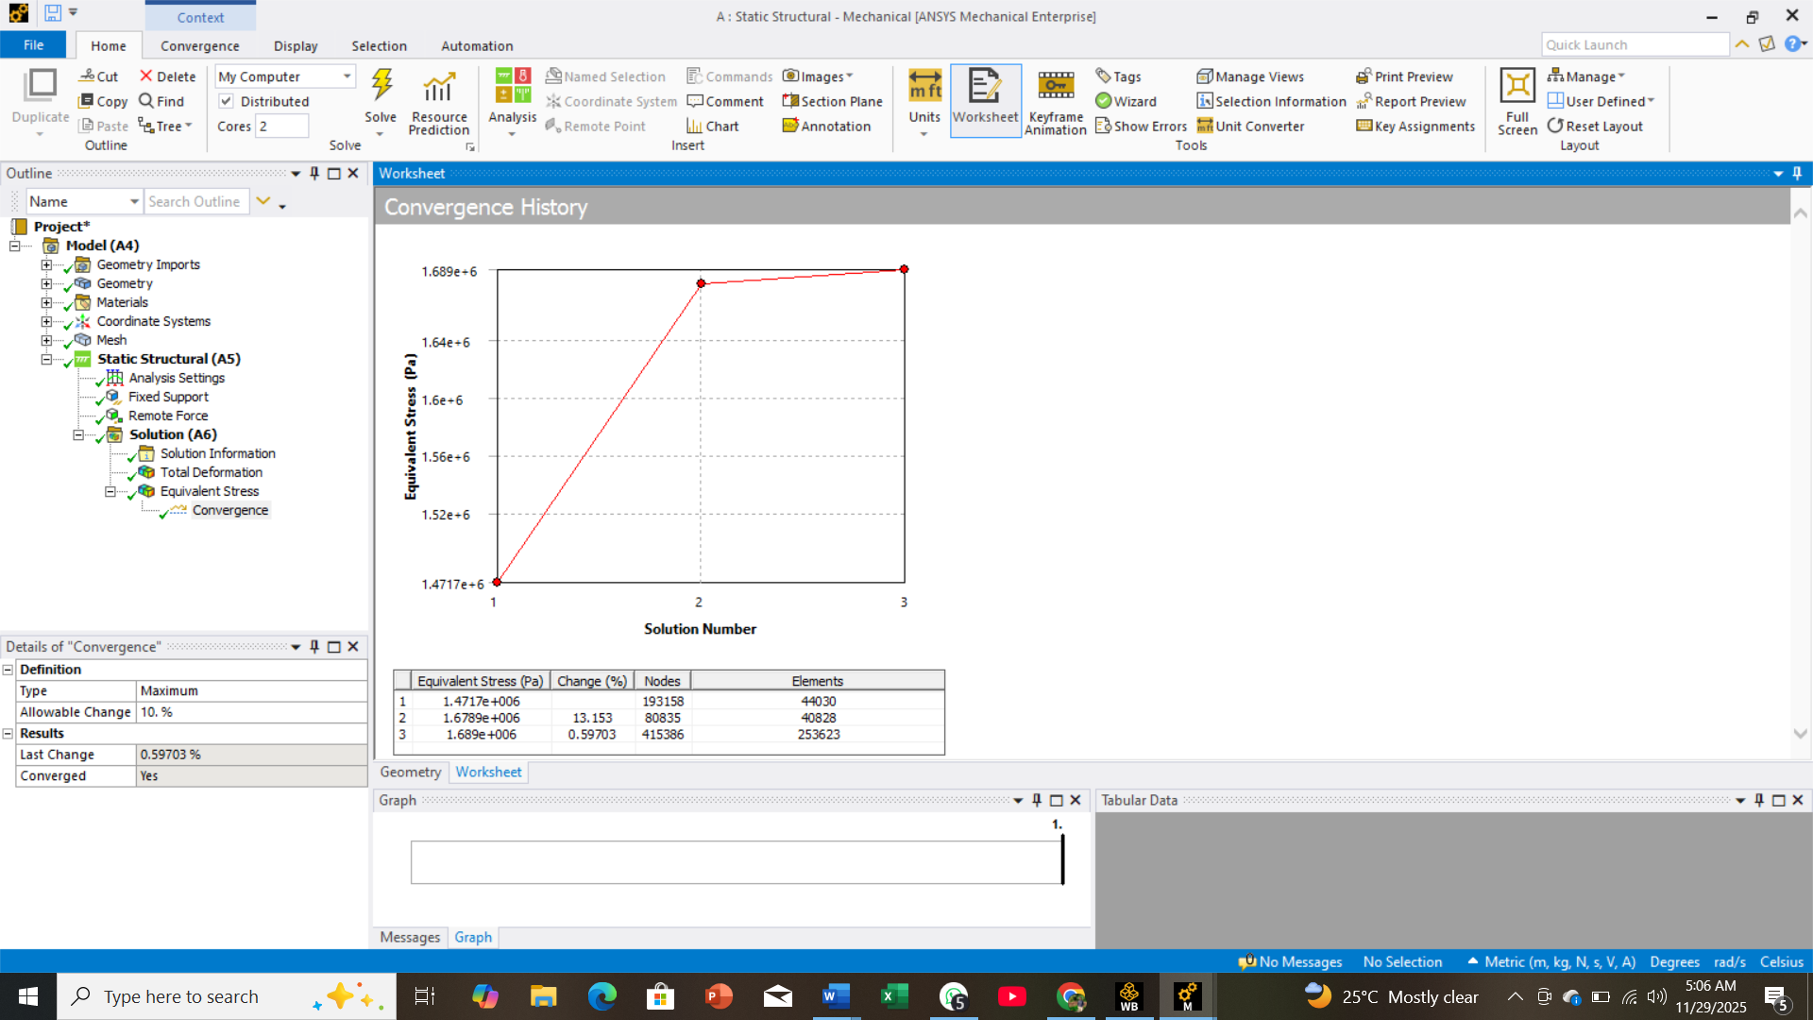
Static Structural Simulation: Results
Total Deformation
Equivalent Stress (von Mises)
Mesh Convergence
Maximum deformation occurred opposite the fixed support, with smooth and symmetric distribution.
Highest stress concentrated near the fixed face and load application region, confirming linear elastic behavior.
Fine mesh achieved stable stress/deformation values, validating its use for simulation.

Slide 8



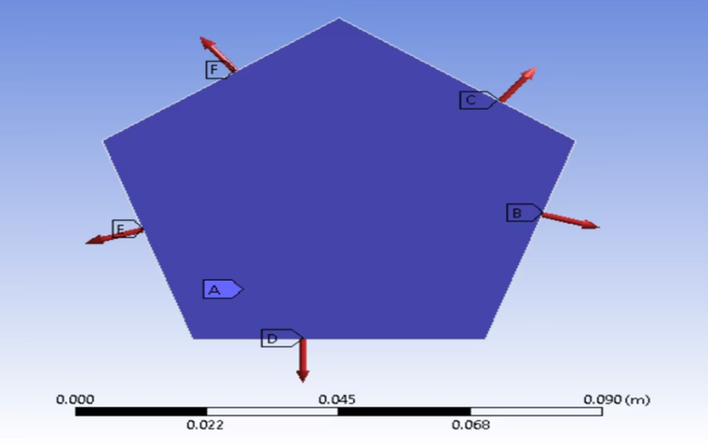

Transient Structural Simulation: Loading & Time
Boundary Conditions
Force Input
Front face fully fixed; forces applied on the remaining five faces.
Each face received time-varying forces based on peak USD→PKR exchange rates (1 USD = 281.5 PKR, applied force = 281.5 N).
Time Step
5 steps, 0.2-second time step, 1.0-second total simulation.

Slide 9
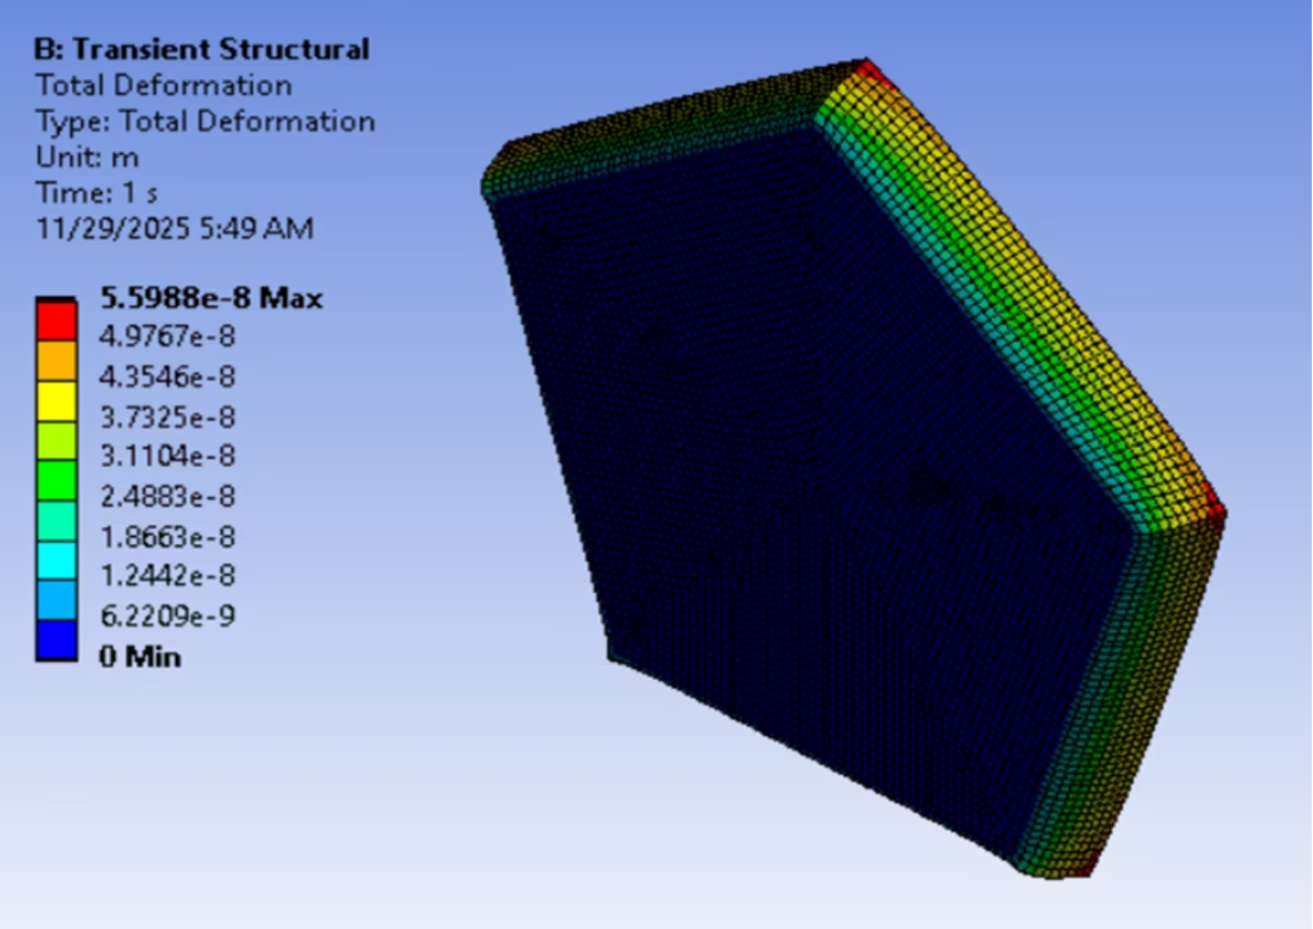
Transient Structural Simulation: Deformation
Deformation vs. Time
Deformation fluctuated based on combined directional forces. Higher exchange-rate peaks led to greater displacement.
Maximum deformation shifted across corners/edges.
Largest deformation occurred on faces opposite the fixed boundary.
Asymmetric deformation due to uneven load directions.

Slide 10
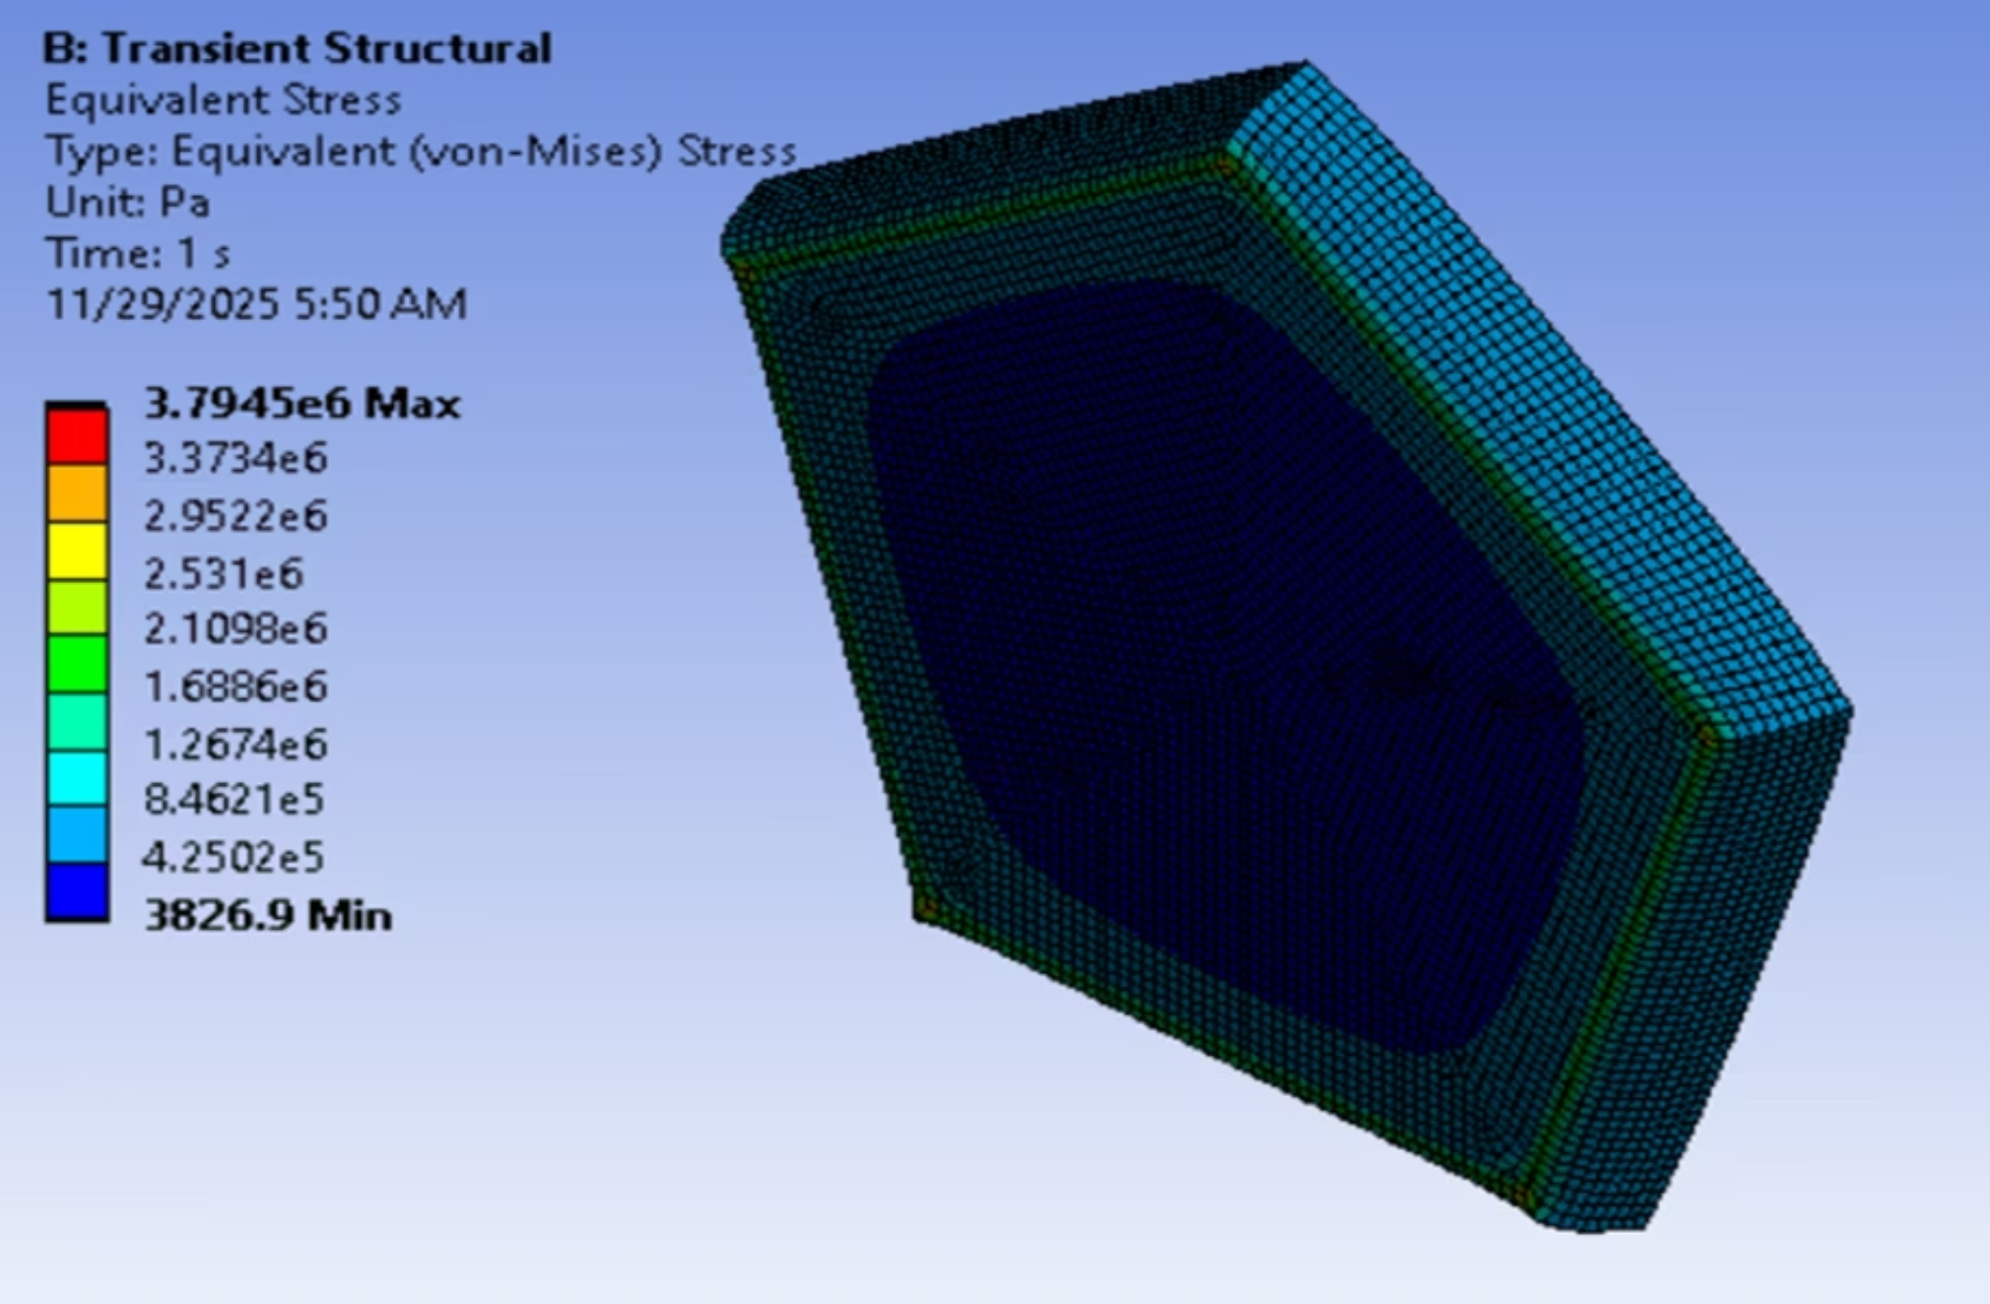
Transient Structural Simulation: Stress Response
Stress-Time Response
Dynamic stress distribution, constantly shifting high-stress zones, different from the static case.
Peak stresses at edges connected to the fixed face.
Maximum von Mises stress during highest applied forces.
Stress concentrated near fixed bottom face and loaded corners.

